Slide 1


APPLICATIONS OF LLM IN NLP
CCDS - NTU
DEC 2024
Welcome To NTU

Slide 2

Welcome to NTU
Workshop that will run from 10am to 2.45pm
Focused on NLP and its practical use cases

Slide 3
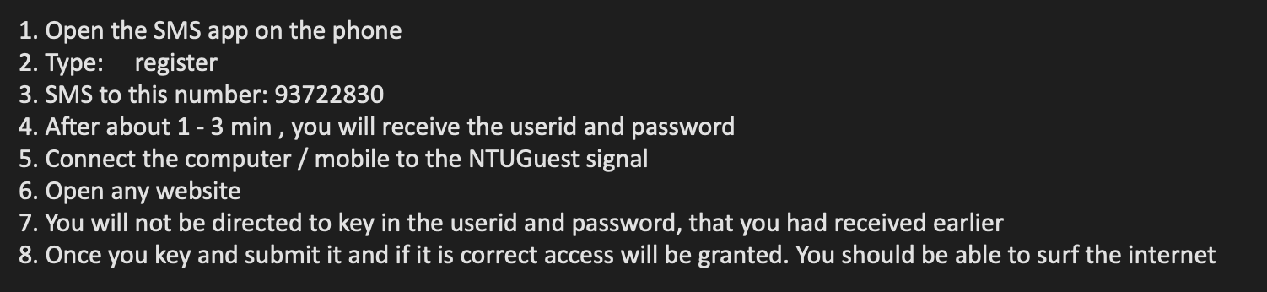
Welcome to NTU
Workshop that will run from 10am to 2.45pm
Focused on NLP and its practical use cases

Slide 4
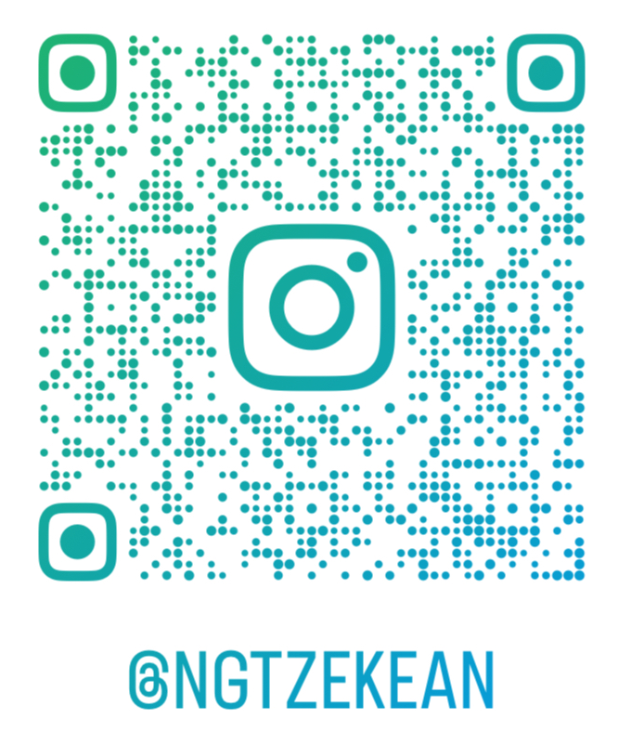
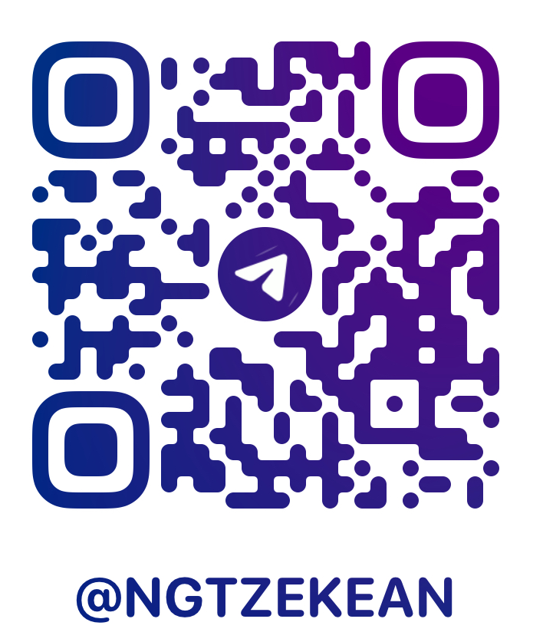

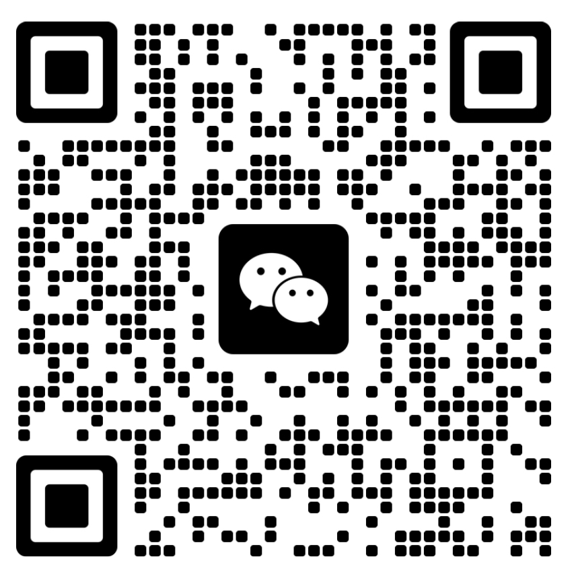
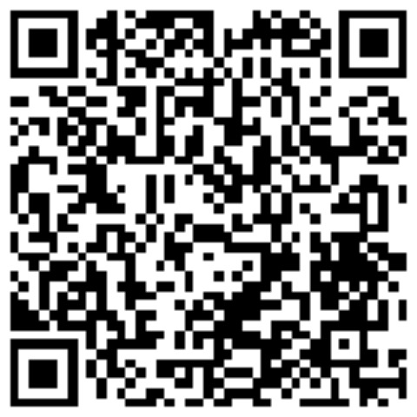
Ng Tze Kean
Insta
Tele
Github
Year 4 Computer Science
Minor in Business
CCDS/ COE/ GEM Ambassador
Aspiring to enter the finance industry!
WeChat
LinkedIn

Slide 5
Plan for today
Word2Vec workshop (1hour)
RNN workshop (30min)
RNN practical (30min)
Lunch break (45min)
LLM workshop (30min)
LLM practical (30min)

Slide 6
Plan for today
Word2Vec workshop (10:30)
RNN workshop (11:30)
RNN practical (12:30)
Lunch break (1:45)
LLM workshop (2.15)
LLM practical (2.45)

Slide 7
Question about NTU?
Student life
Internship
Hall
Studies

Slide 8
Theme
How can we use AI to promote one of the three
Sustainability
Inclusivity
Resilience

Slide 9
Factors to consider
Well defined topic
Targeted scope and audience
Implementation of solution
Technical difficulty of solution
Feasibility of implementation
Scalability and Profitability

Slide 10
Examples
https://devpost.com/software/visuai
https://devpost.com/software/team-52-5e
https://github.com/HiIAmTzeKean/SC4001-NLarge

